Slide 1
To be able to count to 100
Success criteria:
I can use mathematical equipment and pictorial representations, such as number tracks, to help me count forwards and backwards within 100, grouping tens to count more quickly.

Slide 2


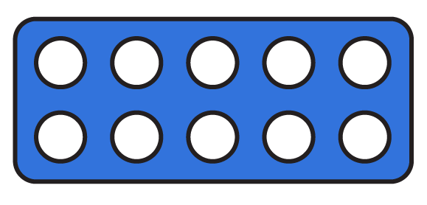
To be able to count to 100
Starter:
What’s the same? What’s different?
Explain your answer.

Slide 3
To be able to count to 100
Starter:
What’s the same? What’s different?
The Numicon shapes represent 23.
There are thirteen 1 counters. So, they have the same amount of 1s, but a different amount of tens 10s.

Slide 4
To be able to count to 100
Talking Time:
Have a bundle of objects, straws work well.
Ask children to bundle the objects into as many groups of ten as possible.
They should be taught to count the tens first, then count the leftover parts to find the ones.
If you don’t have any straws you could use pencils or twigs.

Slide 5
To be able to count to 100
Talking Time:
Have a bundle of objects, straws work well.
Ask children to bundle the objects into as many groups of ten as possible.
They should be taught to count the tens first, then count the leftover parts to find the ones.

Slide 6
To be able to count to 100
How could you group them?
Talking Time:
How many bananas are there?
There are ___ bananas.

Slide 7
To be able to count to 100
Talking Time:
How many bananas are there?
There are 15 bananas.

Slide 8
To be able to count to 100
Talking Time:
How many bananas are there?
There are ___ bananas.

Slide 9
To be able to count to 100
Talking Time:
How many bananas are there?
There are 19 bananas.

Slide 10
To be able to count to 100
Talking Time:
How many bananas are there?
There are ___ bananas.

Slide 11
To be able to count to 100
Talking Time:
How many bananas are there?
There are 20 bananas.

Slide 12
To be able to count to 100
Activity 1:
How many bananas are there?
There are ___ bananas.

Slide 13
To be able to count to 100
Activity 1:
How many bananas are there?
There are 23 bananas.

Slide 14
To be able to count to 100
Talking Time:
How many apples are there?
There are ___ apples.

Slide 15
To be able to count to 100
Talking Time:
How many apples are there?
There are ___ apples.

Slide 16
To be able to count to 100
Talking Time:
How many apples are there?
There are 24 apples.

Slide 17
To be able to count to 100
Talking Time:
How many apples are there?
There are ___ apples.

Slide 18
To be able to count to 100
How many groups of ten?
Talking Time:
How many apples are there?
There are 32 apples.

Slide 19
To be able to count to 100
Talking Time:
How many apples are there?
There are ___ apples.

Slide 20
To be able to count to 100
Talking Time:
How many apples are there?
There are 45 apples.

Slide 21
To be able to count to 100
Activity 2:
How many apples are there?
There are ___ apples.

Slide 22
To be able to count to 100
Activity 2:
How many apples are there?
There are 63 apples.

Slide 23
To be able to count to 100
Talking Time:
How many cookies are there?
There are ___ cookies.

Slide 24
To be able to count to 100
Talking Time:
How many cookies are there?
There are 42 cookies.

Slide 25
To be able to count to 100
Talking Time:
Use a hundred grid to do some counting practice.
For example:
Counting forwards from 70 to 84.
Counting backwards from 63 to 56…
Count out loud to your grown up

Slide 26
To be able to count to 100
Copy into your book and put in the missing numbers.
Talking Time:
Complete the number track below:
44 | 45 | 46 | 47 | 48 | 49 | 50 | 51

Slide 27
To be able to count to 100
Talking Time:
Complete the number track below:
67 |  |  |  |  | 72 | 73

Slide 28
To be able to count to 100
Talking Time:
Complete the number track below:
85 |  |  |  |  | 80 | 79

Slide 29
To be able to count to 100
Activity 4:
Complete the number tracks below:
56 | 57 | 58 | 59 | 60 | 61 | 62 | 63
93 | 94 | 95 | 96 | 97 | 98 | 99 | 100
91 | 90 | 89 | 88 | 87 | 86 | 85 | 84

Slide 30
To be able to count to 100
Activity 5:
Are the following statements true or false?
Ahmed says, “If I am counting backwards from 83, the next number is 82.”
Yasmin says, “If I am counting backwards from 99 the next number is 100.”
Jamal says. “If I am counting forwards from 87, the next number is 86.”
Explain your answers.

Slide 31
To be able to count to 100
Activity 5:
Are the following statements true or false?
Ahmed says, “If I am counting backwards from 83, the next number is 82.”
True!
Yasmin says, “If I am counting backwards from 99 the next number is 100.”
False – the next number is 98, Yasmin has counted forwards!
Jamal says. “If I am counting forwards from 87, the next number is 86.”
False – the next number is 88, Jamal has counted backwards!

Slide 32
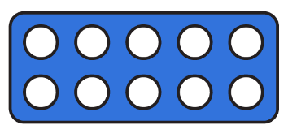


To be able to count to 100
Evaluation:
Do you agree with Astrobee?
Explain your answer.
The number shapes represent nine, because 4 + 5 = 9.

Slide 33
To be able to count to 100
Evaluation:
No, I do not agree. There are four blue pieces, each representing 10, and one red piece, representing 5, so the number shapes make a total of 45.
The number shapes represent nine, because 4 + 5 = 9.

Slide 34
To be able to count to 100
Success criteria:
I can use mathematical equipment and pictorial representations, such as number tracks, to help me count forwards and backwards within 100, grouping tens to count more quickly
I can explain my reasoning when using mathematical equipment and pictorial representations, such as number tracks, to help me count forwards and backwards within 100, and when grouping tens to count more quickly

