Slide 1
Year 2 Wednesday 10th June 2020 Summer Block 4: Mass, Capacity and Temperature
Lesson 1: To be able to compare mass
Summer
Block 4 – Mass, Capacity and Temperature
1

Slide 2
To be able to compare mass Mass: Choose whether you would measure items in grams or kilograms. Normally something heavy would be measured in Kilograms (1000g) and something lighter in grams.

Slide 3
To be able to compare mass Mass: Choose whether you would measure items in grams or kilograms. What can you see in your home that you’d measure in Kilograms? What can you see that you would measure in grams? What would you measure your own mass in?

Slide 4
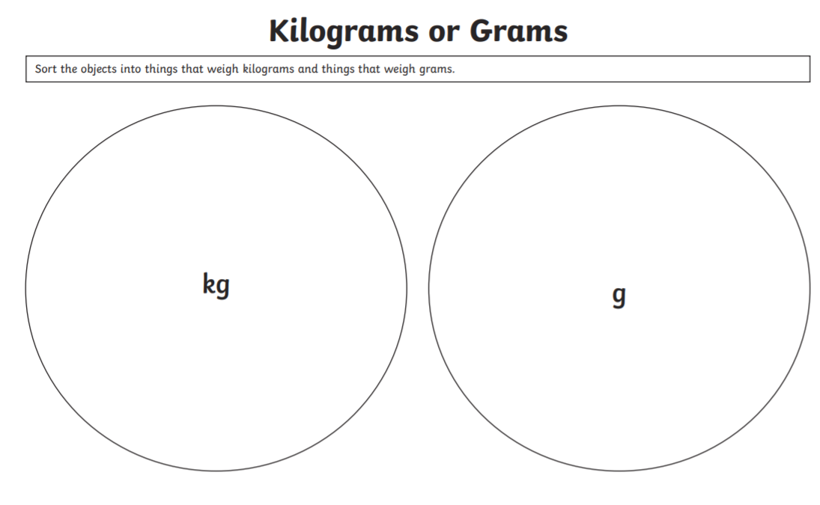
Sort Objects in to those you would measure in Kilograms and those you would measure in grams
You could:
*draw the circle in your book and draw the objects to sort them
*print the worksheets (separate pdf) and cut & stick
*or you could make two groups of objects at home and label them and take a photo!

