Slide 1
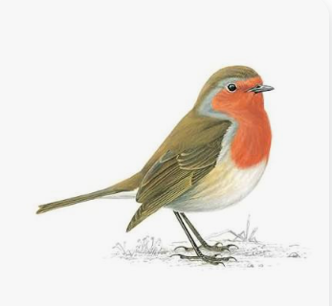
Robins Meet the Teacher

Slide 2
People working in Robins Class.
Mrs Edmond
(class teacher)
Mrs Goude
(TA)
Miss Hay
(Wednesday afternoon)

Slide 3
Most important message for you to remember from today!!
Please, please, please
Label everything!!
Including water bottles, outdoor coats and shoes!!
We try our best to return all items but all items of uniform look the same. We even do the sniff check to try and return items!!

Slide 4
Snack!
We do provide a snack daily. It varies from bananas, apples, oranges, pears and other seasonal fruit. Milk is also available.
If you want to provide your child with their own snack please make sure it is ‘healthy’. No chocolate, biscuits ( crackers are ok ) crisps or sweets.
Snack time is only 10 minutes!

Slide 5
Reading.
Year 1. Reading for pleasure book.
        Library book
        RWI small book (read in class)
        RWI book bag book (not read)
        Reception children will only bring home a reading for pleasure book and a library book for the first 3/4 weeks.
        Look out for the early reading and phonics meeting later this term

Slide 6
Expectations for home.
Reading. At least 3 times a week. A couple of pages. Please record in reading record. Class race track.
Year 1. Spellings. Practice at home. Given on a Monday and tested the following Monday.
Reception. Phonics. Short videos will be sent home via dojo to practice the sound of the day. ( 4 a week )

Slide 7
PE days are Tuesday and Wednesday.
PE kits can be brought on a Monday and they will be sent home on a Friday.
We will be starting Forest school after Christmas. More information nearer the time.

Slide 8
Any concerns or questions after this meeting.
Feel free to catch me on the gate, morning or afternoon for quick messages.
Email/phone the office.
Message on Class Dojo. If you message direct to me it is a private message. You can send photos and videos this way too!!

