Slide 1
22.3.22
L.O. Measure capacity
Year 4 Hundredths
Success criteria:
Say which equipment is used to measure capacity.
Explain the difference between volume and capacity.
Read a scale.
Measure capacity in ml and l.
Say how many ml are equal to a l.
Recognise that hundredths arise from dividing one whole into one hundred equal parts.
Count in hundredths and represent tenths and hundredths on a place value grid and a
number line.

Slide 2
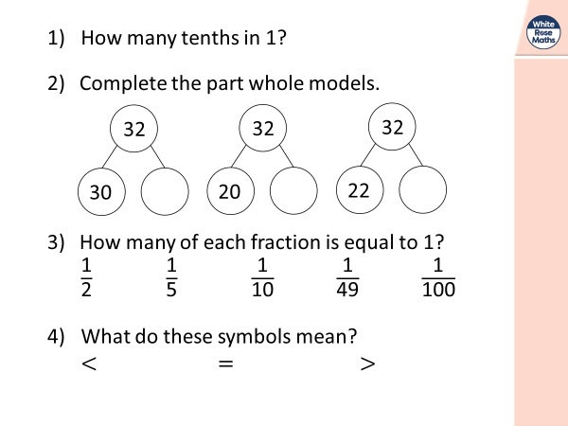
Year 3
Year 4

Slide 3
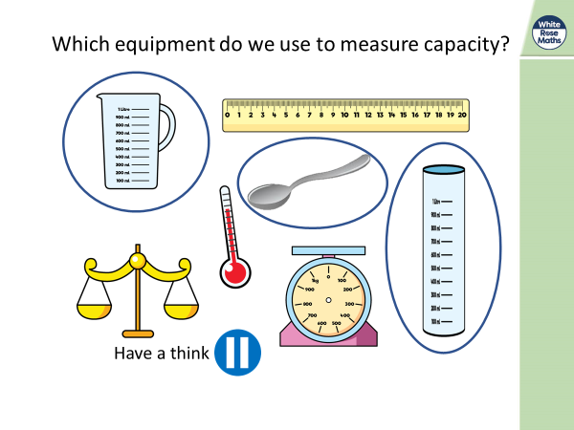
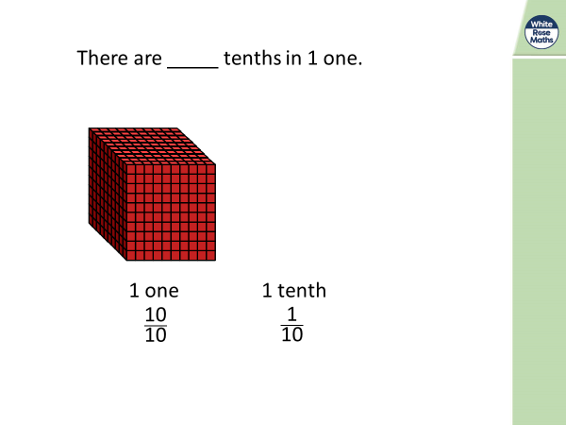
Year 3
Year 4

Slide 4
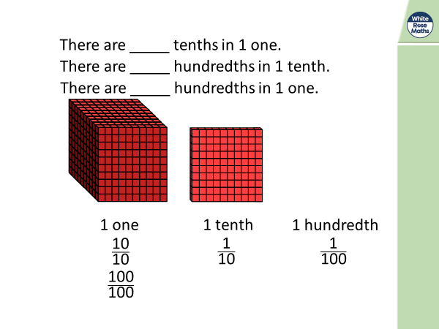
Year 3
Year 4

Slide 5
Year 3
Year 4
How many ml does he have?

Slide 6
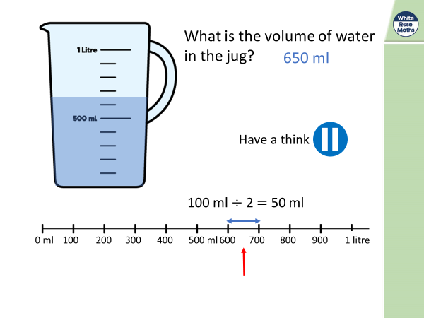
Year 3
Year 4

Slide 7
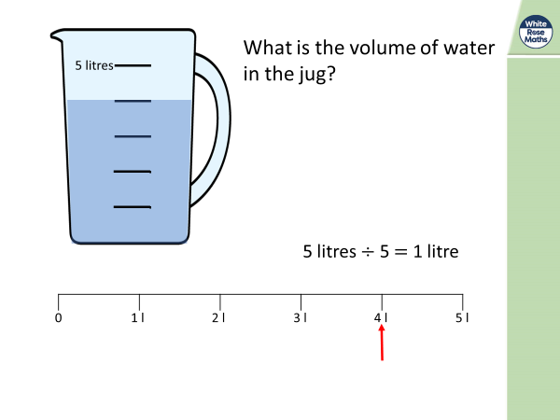
Year 3
Year 4

Slide 8
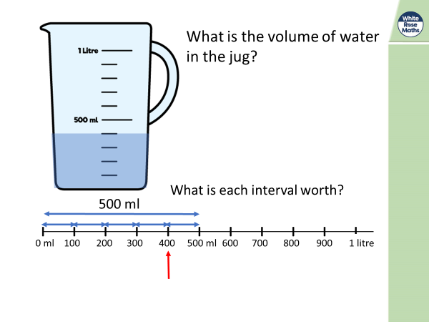
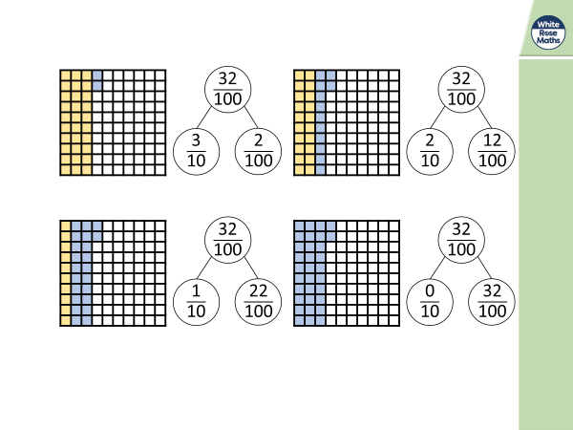
Year 3
Year 4

Slide 9
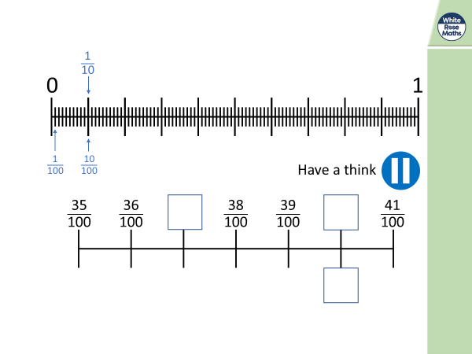
Year 3
Year 4

Slide 10
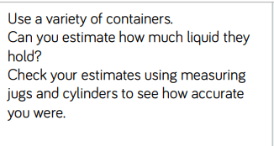
Year 3

