Slide 1
Year 2
Capacity and Volume
16.6.20 & 17.6.20 Summer Block 4: Mass, Capacity and Temperature
Lesson 5: To be able to measure volume in ml
Summer
Block 4 – Mass, Capacity and Temperature

Slide 2
To be able to measure volume in ml
Success criteria:
I can use different scales to measure volume in ml
I can explain my reasoning when using different scales to measure volume in ml

Slide 3
Tuesday 16th June 2020

Slide 4
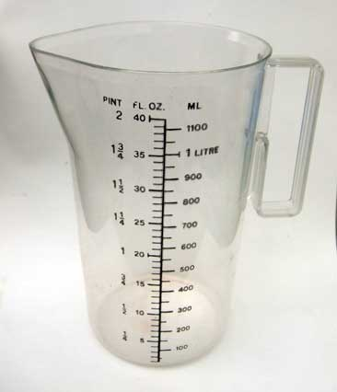
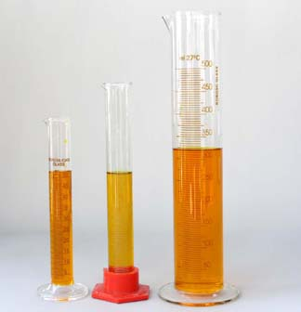
Standard units of measurement for capacity and volume.
One of the standard ways to measure capacity is in litres.
There are 1000 millilitres in a litre.
1L = 1000ml

Slide 5
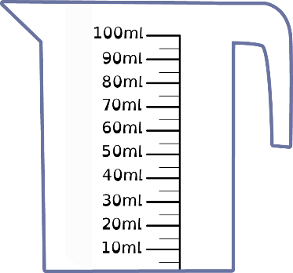
To be able to measure volume in ml
Starter:
Which is the odd one out?
Explain your answer.

Slide 6
To be able to measure volume in ml
Starter:
Which one doesn’t belong?
The second - as it is empty. The orange jug holds 80 ml of juice, the green jug holds 65 ml of juice and the purple jug holds 50 ml of juice.

Slide 7
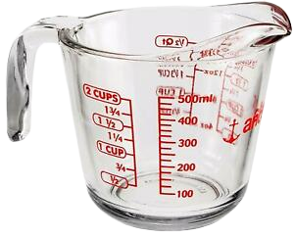
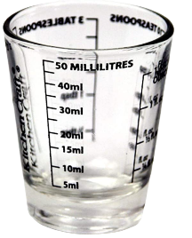
To be able to measure volume in ml
PRACTICAL – at home!
Do some measuring in ml practice pouring various amounts of liquid in and out of different containers with various ml scales. Practise reading the scales with adult help.

Slide 8
Wednesday 7th June 2020
Success criteria:
I can use different scales to measure volume in ml
I can explain my reasoning when using different scales to measure volume in ml
There’s lots of practise reading scales today and then some practise worksheets at the end if you want to print them.

Slide 9
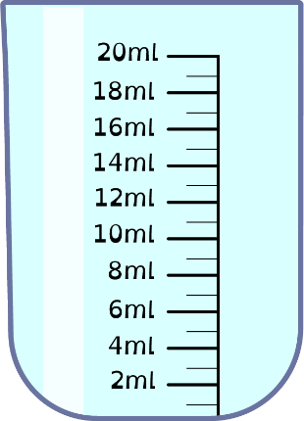
To be able to measure volume in ml
Talking Time:
Jamal pours 8 ml of juice into the container below.
Where should I draw a line to show how much of the container the juice fills?

Slide 10
To be able to measure volume in ml
Talking Time:
Jamal pours 8 ml of juice into the container below.
Where should I draw a line to show how much of the container the juice fills?

Slide 11
To be able to measure volume in ml
Talking Time:
Ahmed pours 13 ml of juice into the container below.
Where should I draw a line to show how much of the container the juice fills?

Slide 12
To be able to measure volume in ml
Talking Time:
Ahmed pours 13 ml of juice into the container below.
Where should I draw a line to show how much of the container the juice fills?

Slide 13
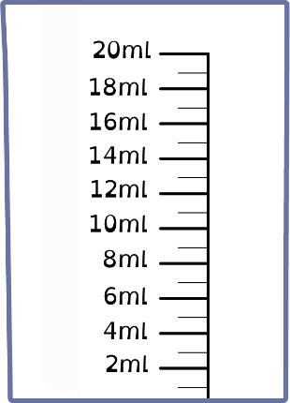
To be able to measure volume in ml
Talking Time:
Eve pours 7 ml of juice into the container below.
Where should I draw a line to show how much of the container the juice fills?

Slide 14
To be able to measure volume in ml
Talking Time:
Eve pours 7 ml of juice into the container below.
Where should I draw a line to show how much of the container the juice fills?

Slide 15
To be able to measure volume in ml
Talking Time:
Ruth pours 11 ml of juice into the container below.
Where should I draw a line to show how much of the container the juice fills?

Slide 16
To be able to measure volume in ml
Talking Time:
Ruth pours 11 ml of juice into the container below.
Where should I draw a line to show how much of the container the juice fills?

Slide 17
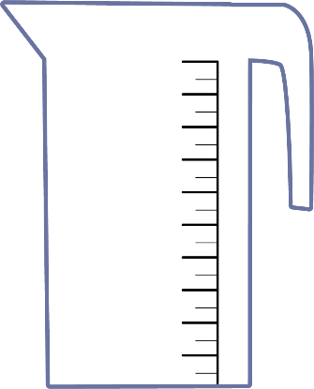
To be able to measure volume in ml
Talking Time:
James pours 10 ml of juice into the container below.
Where should I draw a line to show how much of the container the juice fills?
20 ml
10 ml

Slide 18
To be able to measure volume in ml
Talking Time:
James pours 10 ml of juice into the container below.
Where should I draw a line to show how much of the container the juice fills?
20 ml
10 ml

Slide 19
To be able to measure volume in ml
Talking Time:
Yasmin pours 12 ml of juice into the container below.
Where should I draw a line to show how much of the container the juice fills?
20 ml
10 ml

Slide 20
To be able to measure volume in ml
Talking Time:
Yasmin pours 12 ml of juice into the container below.
Where should I draw a line to show how much of the container the juice fills?
20 ml
10 ml

Slide 21
To be able to measure volume in ml
Talking Time:
Chen pours 17 ml of juice into the container below.
Where should I draw a line to show how much of the container the juice fills?
20 ml
10 ml

Slide 22
To be able to measure volume in ml
Talking Time:
Chen pours 17 ml of juice into the container below.
Where should I draw a line to show how much of the container the juice fills?
20 ml
10 ml

Slide 23
To be able to measure volume in ml
Activity 1:
Where should the line be drawn on each of these containers to show the amount given below?
20 ml
10 ml
15 ml
4 ml
19 ml

Slide 24
To be able to measure volume in ml
Activity 1:
Draw lines on each of the containers to show the amount given below.
20 ml
10 ml
15 ml
4 ml
19 ml

Slide 25
To be able to measure volume in ml
Talking Time:
Eve pours 1,000 ml of juice into the container below.
Where should I draw a line to show how much of the container the juice fills?
1,000 ml

Slide 26
To be able to measure volume in ml
Talking Time:
Eve pours 1,000 ml of juice into the container below.
Where should I draw a line to show how much of the container the juice fills?
1,000 ml

Slide 27
To be able to measure volume in ml
Talking Time:
Chen pours 500 ml of juice into the container below.
Where should I draw a line to show how much of the container the juice fills?
1,000 ml

Slide 28
To be able to measure volume in ml
Talking Time:
Chen pours 500 ml of juice into the container below.
Where should I draw a line to show how much of the container the juice fills?
1,000 ml

Slide 29
To be able to measure volume in ml
Talking Time:
Ruth pours 800 ml of juice into the container below.
Where should I draw a line to show how much of the container the juice fills?
1,000 ml

Slide 30
To be able to measure volume in ml
Talking Time:
Ruth pours 800 ml of juice into the container below.
Where should I draw a line to show how much of the container the juice fills?
1,000 ml

Slide 31
To be able to measure volume in ml
Activity 5:
Ahmed has a bottle of juice. If he poured it into the measuring jug, how far up would it fill the jug? Draw a line or shade in the jug to show how much would be filled.
1,000 ml

Slide 32
To be able to measure volume in ml
Activity 5:
Ahmed has a bottle of juice. If he poured it into the measuring jug, how far up would it fill the jug? Draw a line or shade in the jug to show how much would be filled.
1,000 ml

Slide 33
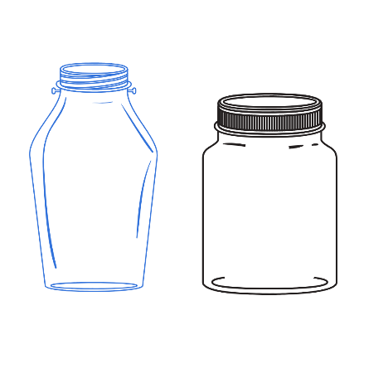
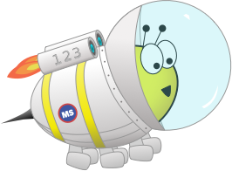
To be able to measure volume in ml
Evaluation:
Do you agree?
Explain your answer.
If the jars have no measurement given, there’s no way to know how much honey they will hold.

Slide 34
To be able to measure volume in ml
Evaluation:
No, I do not agree. Astrobee could fill each jar with water, then pour the water into a measuring container to find out how much honey each jar can hold.
If the jars have no measurement given, there’s no way to know how much honey they will hold.

Slide 35
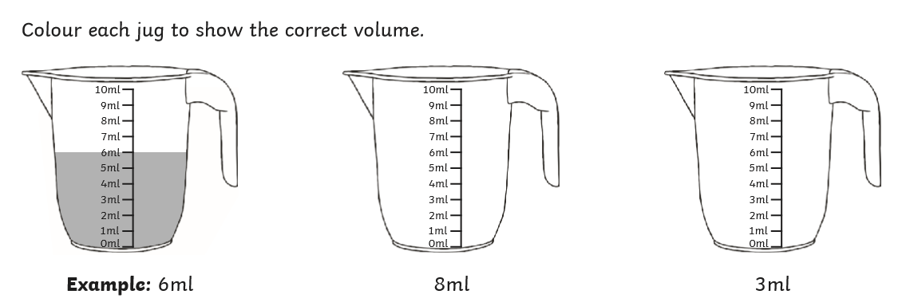
There are some activity pages you can print if you would like to, to support this week’s learning.

Slide 36
To be able to measure volume in ml
Success criteria:
I can use various containers with different scales to measure volume in ml
I can explain my reasoning when using various containers with different scales to measure volume in ml

