Slide 1
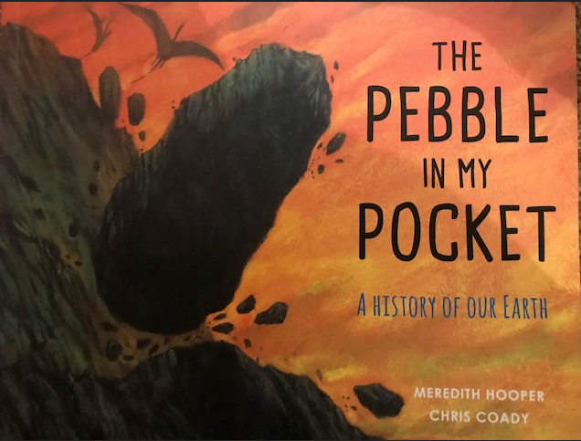

Slide 2
L.O: To apply comprehension skills across writing genres.

Slide 3
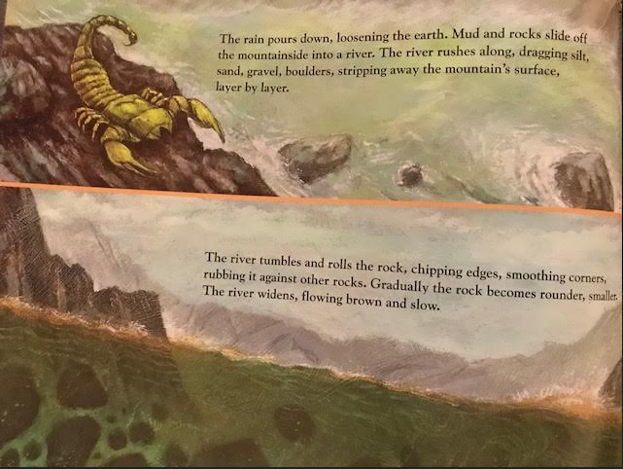
What is happening to the rock?

Slide 4
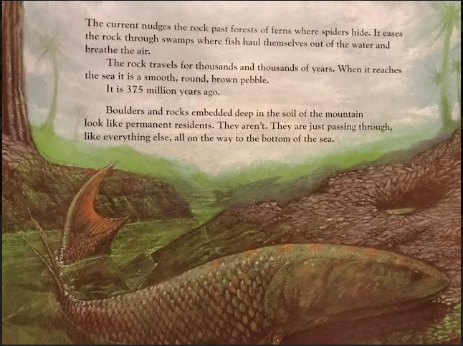
How long has the rock travelled for?
What has the rock become?

Slide 5
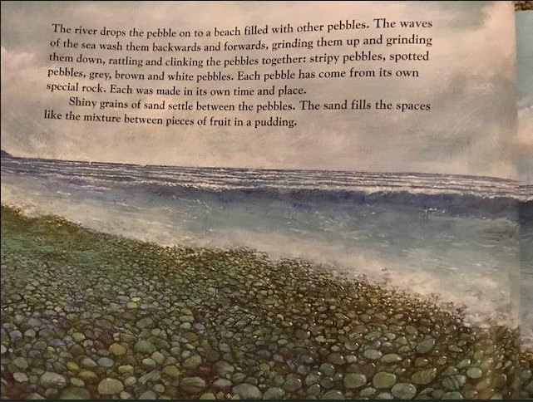
What do the waves do to the pebble?
What can the pebbles look like?
Can you find the similie?

Slide 6
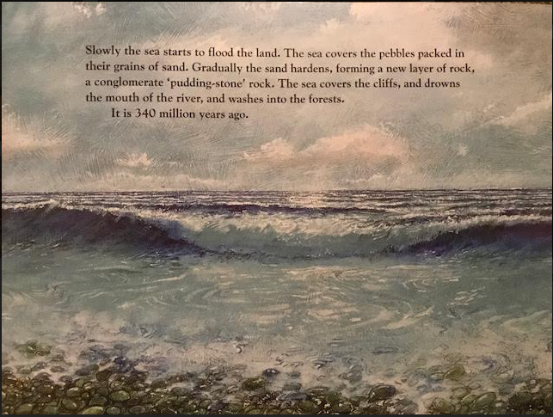
Conglomerate = gathered together in a compact mass

Slide 7
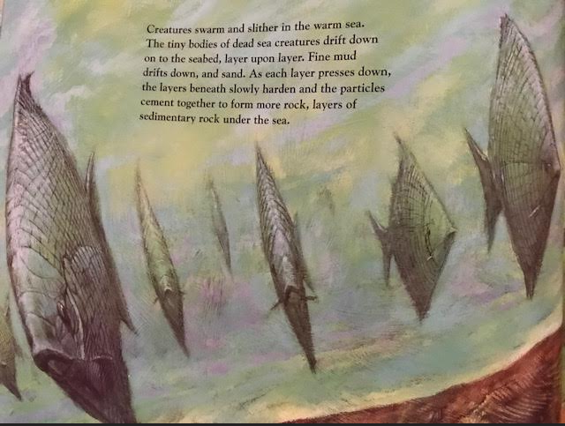
‘Creatures swarm and slither’
What does this make you think of?
How do they move?
Notes:
Talk through the text. Guide the pupil’s understanding of what is happening. Draw out language to do with fish and the movement of fish to build vocabulary and consolidate their understanding.

Slide 8
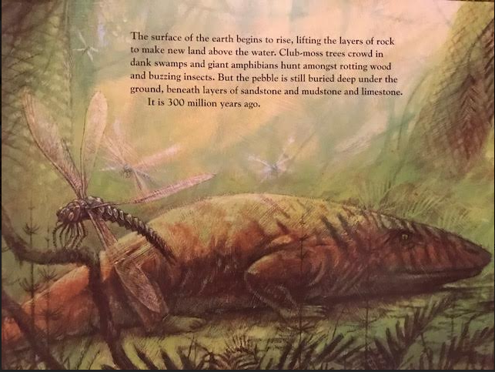
As a class can you move together like fish? Bank words to describe this movement.
Try to create some similes.

Slide 9
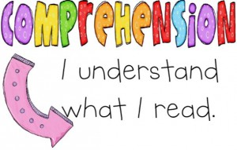
Task: Complete your comprehension questions.
Stick your task in your books. Answer in full sentences in your book.

Slide 10
Plenary
Mark your work as a class. How well did you do? What did you find difficult?

