Slide 1
Tuesday 22nd March

Slide 2
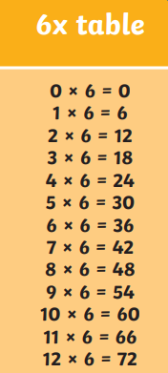
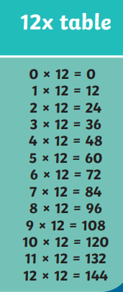
Times Tables
Focus on these times tables
How quickly can you write
them down? And recall the answers.
Which numbers feature in both times tables?
How does this help us with learning?

Slide 3
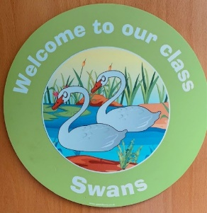
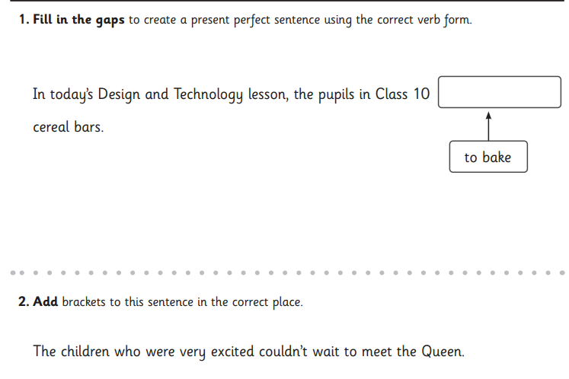
Swans Class Daily SPaG 22nd March 2022

Slide 4
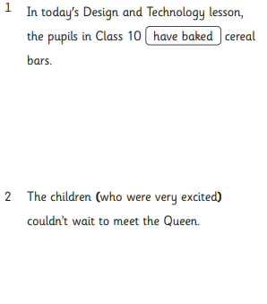
Swans Class Daily SPaG 22nd March 2022

Slide 6
John Hegley
Funny Animal Poems
Watch the videos
Read through and think about the three poems: Armadillo, Peter and Parrot and Owl Poem
How are the three poems different?
How are the three poems the same?
Create your own animal poem in the style of one of these poems
Rhyming, to music, not to music, acrostic style
Work on your own or with a partner
Be ready to share your poem.
video

Slide 7
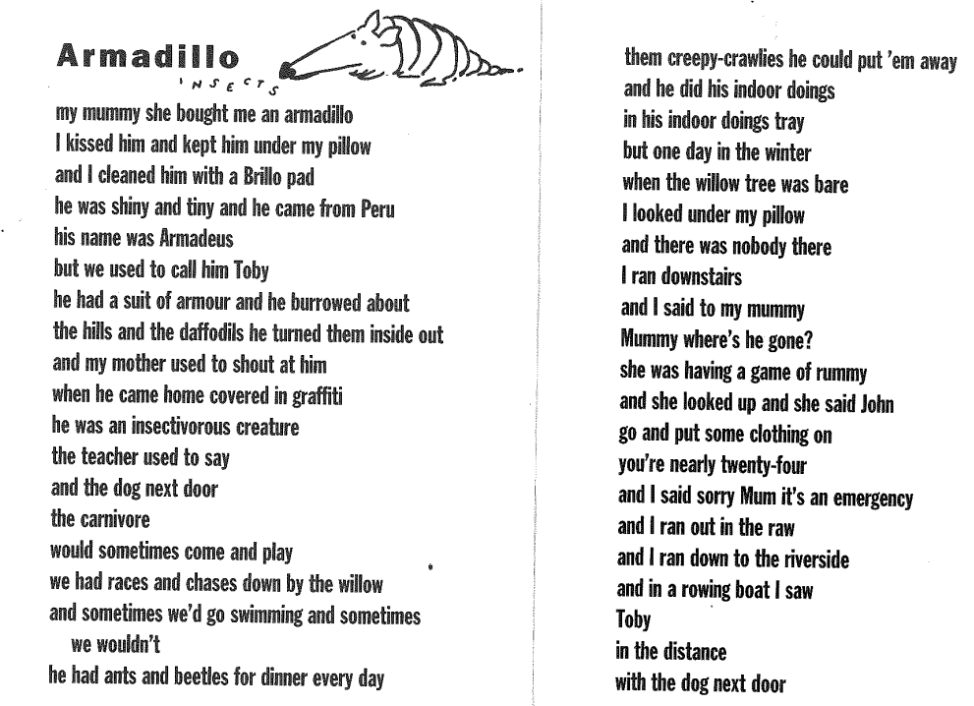

Slide 8
John Hegley
Peter the Parrot
Poem set to music
Peter the poem video

Slide 9
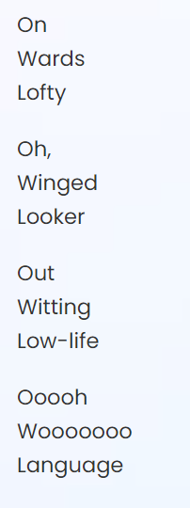
John Hegley
Owl Poem
What do you notice about this poem?
Owl Poem video

Slide 10
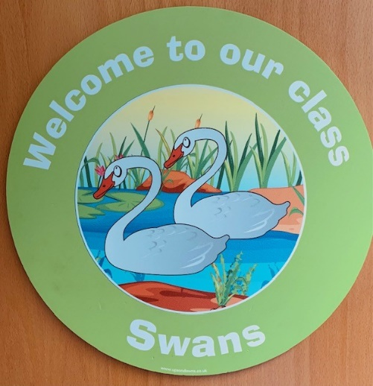
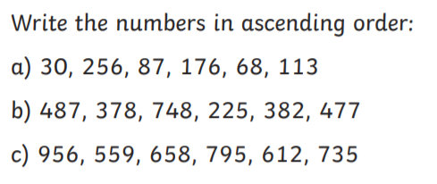
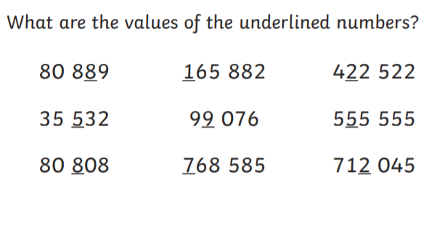
Swans Daily Calculations 22.3.22

Slide 11
Swans Daily Calculations 22.3.22

Slide 12
Maths:
Year 6 SATS reasoning paper 2

Slide 13
ERIC: read to yourself or an adult for 20-30 minutes

Slide 14
History
LO: to use historical sources to find out about the past
What can we find out about the school or Benwick in the past?
What can we use as evidence?
Work with your partner to be a detective.
Use the evidence you have been given to find out about the school or the village.
What kind of historical source do you have?
Is it a Primary Source or a Secondary source? Why?
When is you source from? What period of time does it tell us about?
What can you learn from the source?
What questions do you now have?
I learn that….
I think….
Maybe….
Perhaps….
This shows us that….
I wonder if… I want to know why….. Could it be that….
Be ready to report back and share your information with the class. Record your information in your book.

